Slide 1
Jesus Film
Evange-Hat
Fashion Show

Slide 2
Jesus Film Coordinator Scott Blair

Slide 3
Pleasant View Hat Makers!

Slide 4
500 Evange-bracelets-Pleasant View

Slide 5
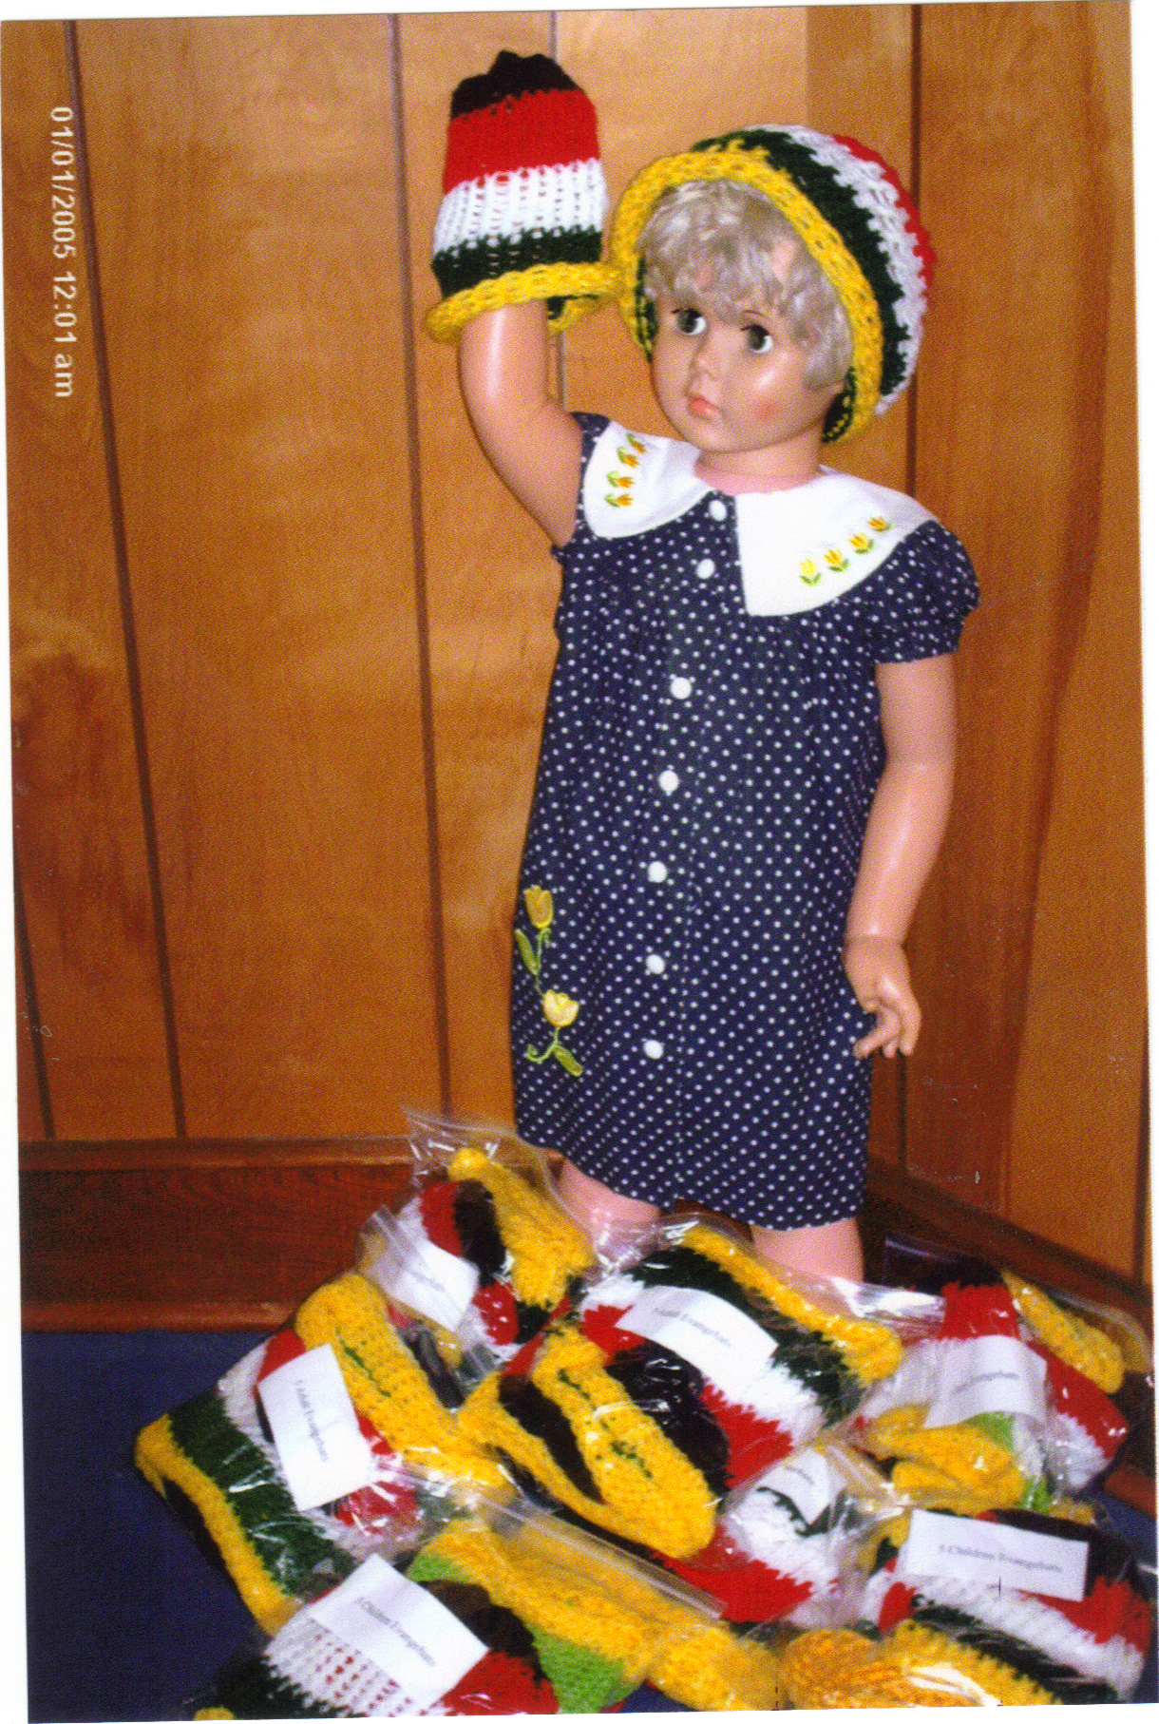
Hundreds of Elizabethton Hats

Slide 6
M’boro 1st Knitter-NMI President Jean Michael

Slide 7
Cookeville Evangehat Cutie

Slide 8
Cookeville “Lineup”

Slide 9
East Ridge Knitters

Slide 10
East Ridge Model

Slide 11
Maryville 1st Church Evangehat knitter

Slide 12
Lenoir city Hats!

